Slide 1
Utica Center for Mathematics, Science, and Technology
Pathways to Success
Peter Paulon, Program Administrator
Program Overview
Q & A

Slide 2
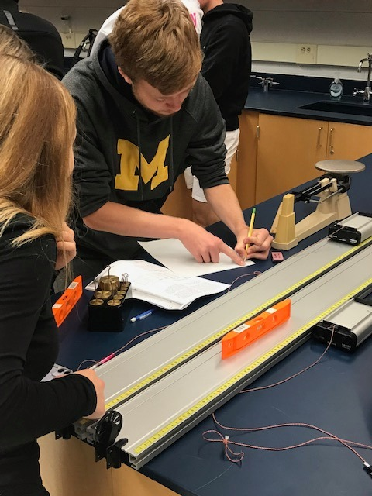
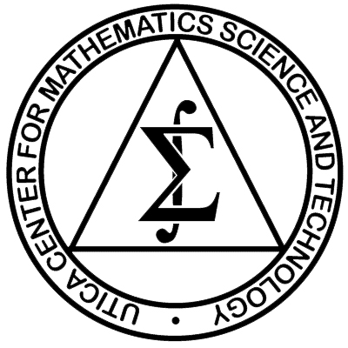
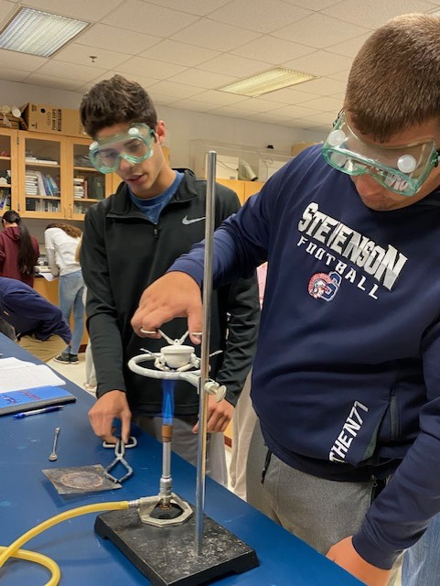

Slide 3
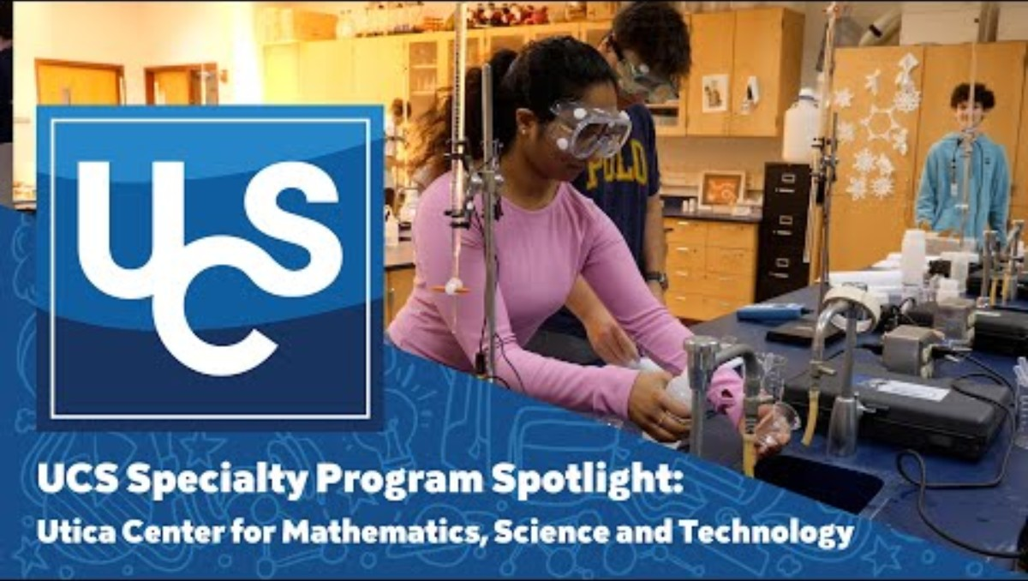

Slide 4
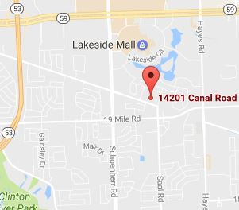
LOGISTICS
Housed at the Instructional Resource Center located at 14201 Canal Rd east of Schoenherr Rd.
UCS provides transportation to MST from the home high school and to home high/junior high school from MST
9th and 10th grade attend from 7:40 am—10:25 am
11th and 12th grade attend from 11:00 am—1:38 pm

Slide 5
Are you a fit for MST?
Is MST a fit for you?
Ask yourself these questions

Slide 6
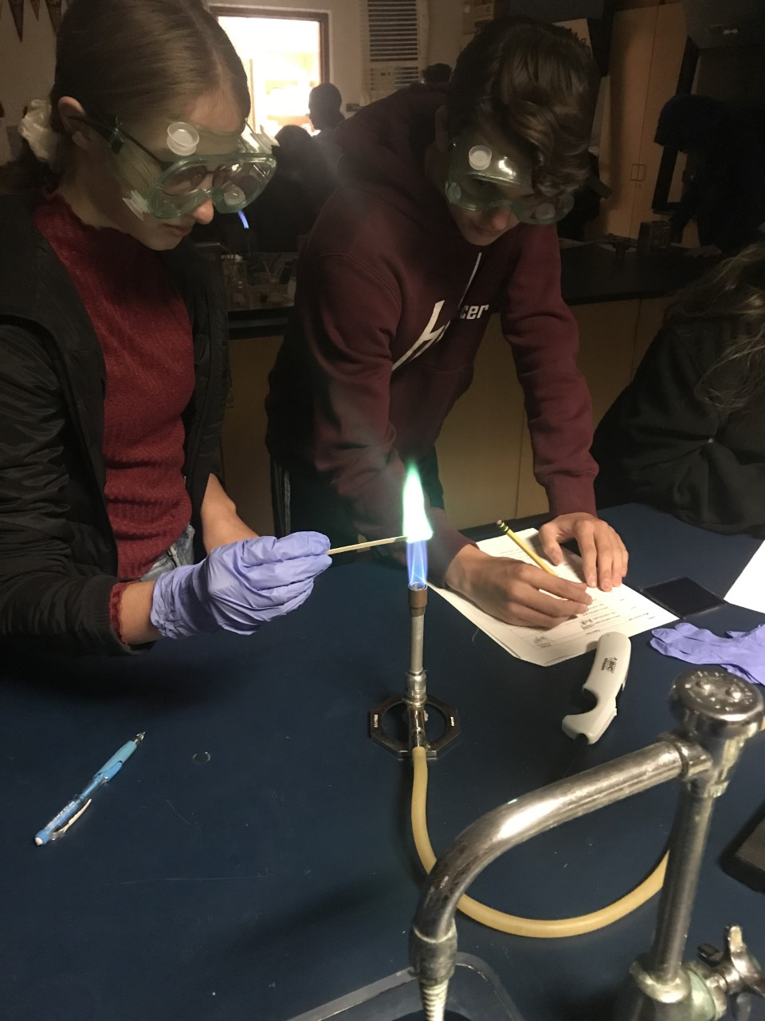
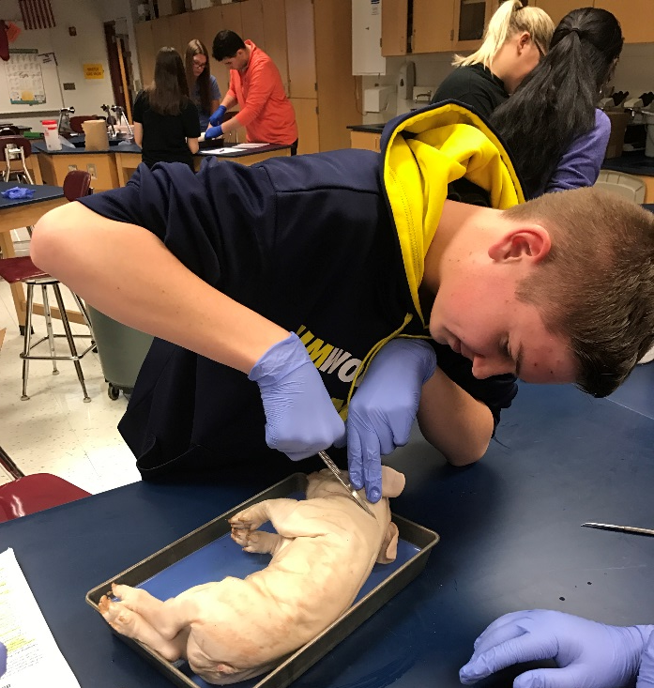
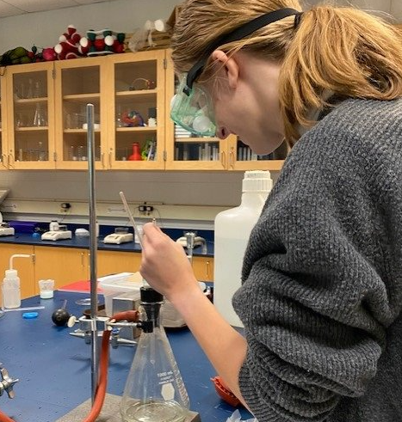
Do you like scientific investigations?

Slide 7
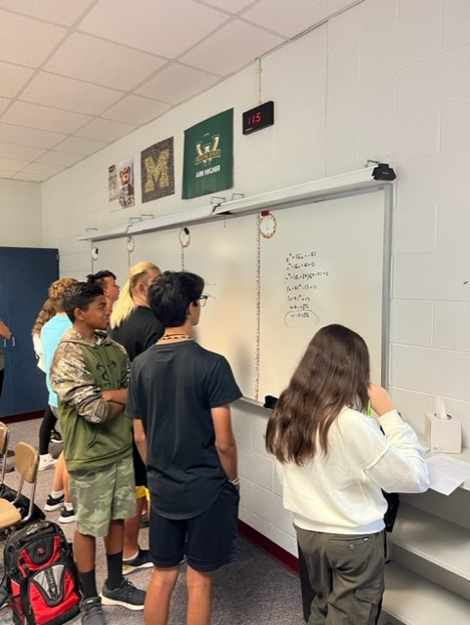
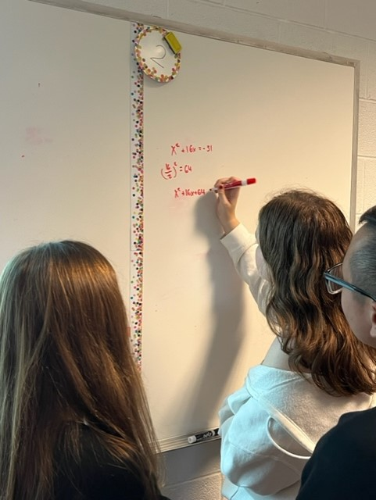
Do you want guaranteed access to the highest-level science and
math classes the district offers?

Slide 8
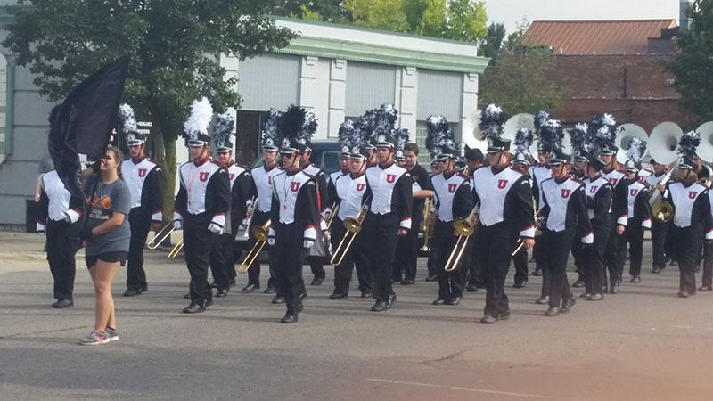
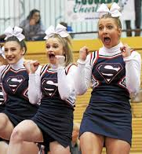
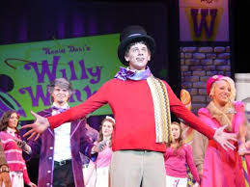
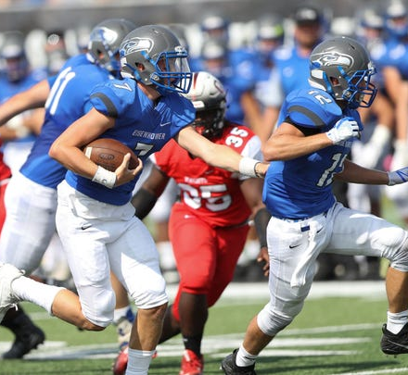
Do you desire a smaller, more individualized math and science learning environment while still connected to everything your home school offers?

Slide 9
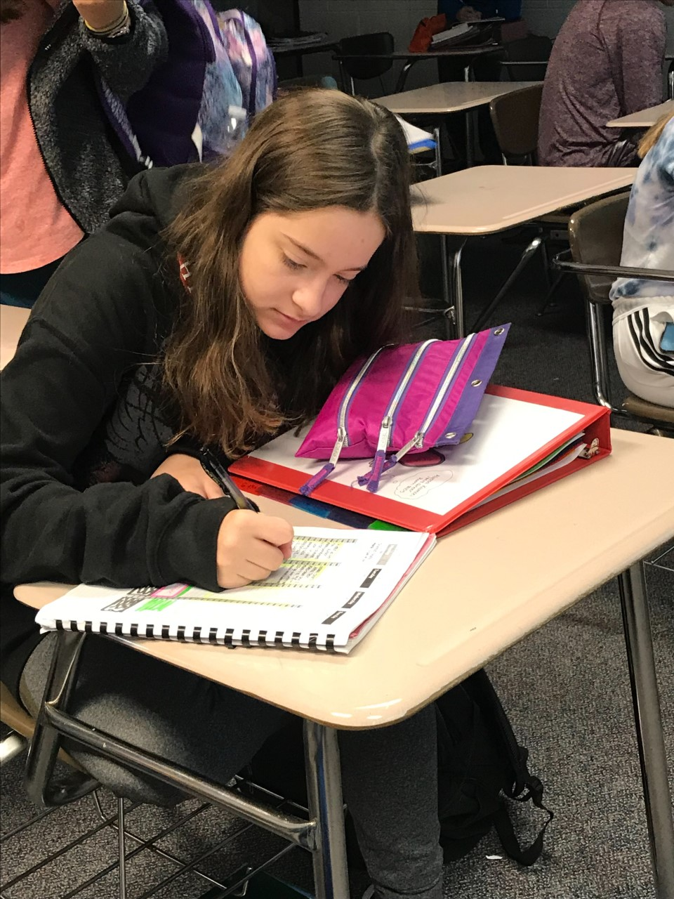
Do these statements describe you?
Algebra I completed by the end of 8th Grade
Good work ethic
Passionate about learning
Dedicated
Motivated
Flexible
Inquisitive
Enjoys a challenge
Wants to maximize advanced placement opportunities

Slide 10
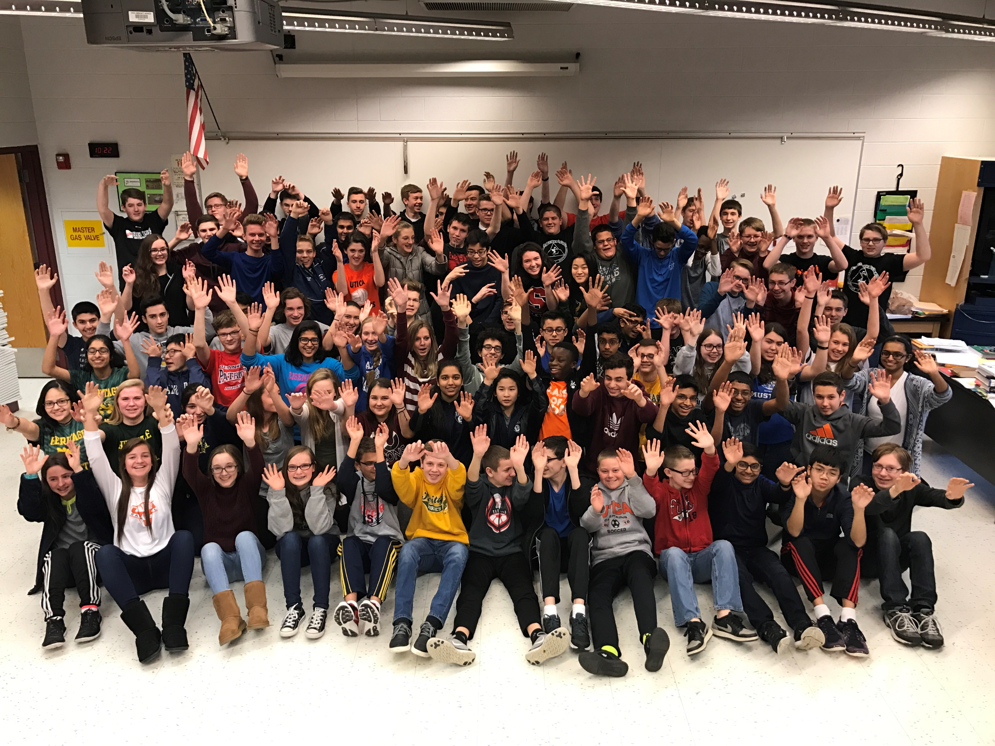
In class with like-minded students
Flexible scheduling
Unique & rigorous math, science and technology classes
Why Choose MST?
Close-knit community atmosphere

Slide 11
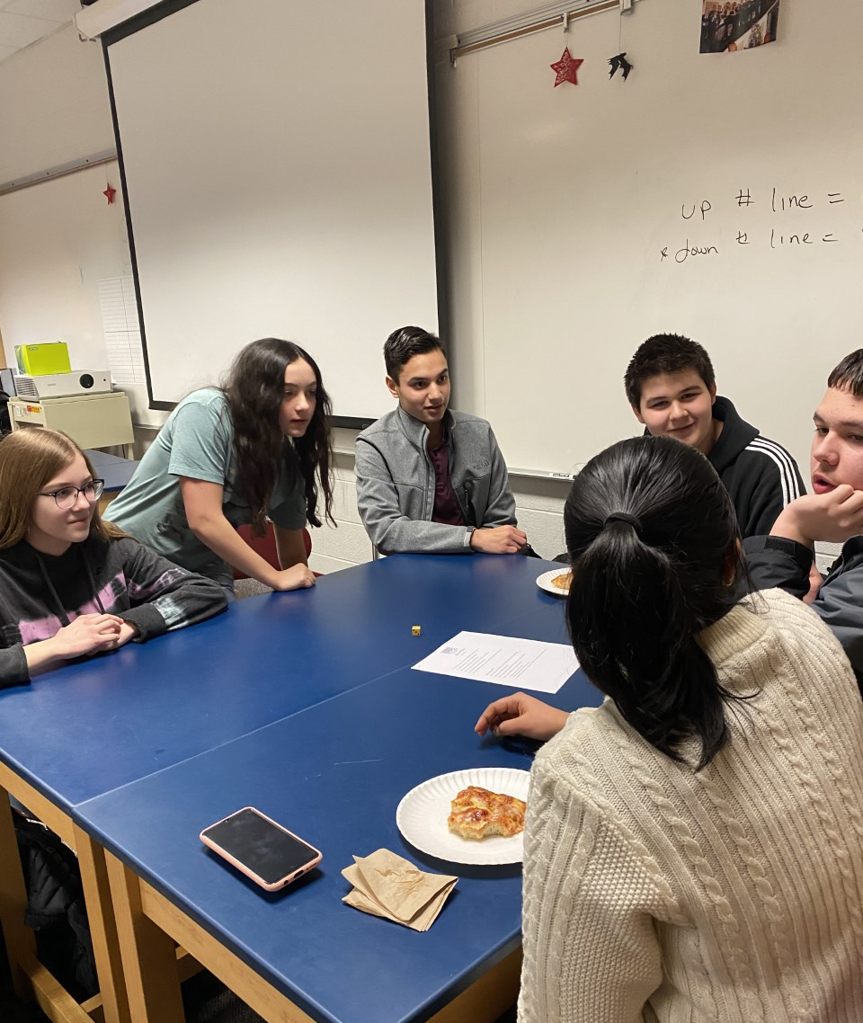
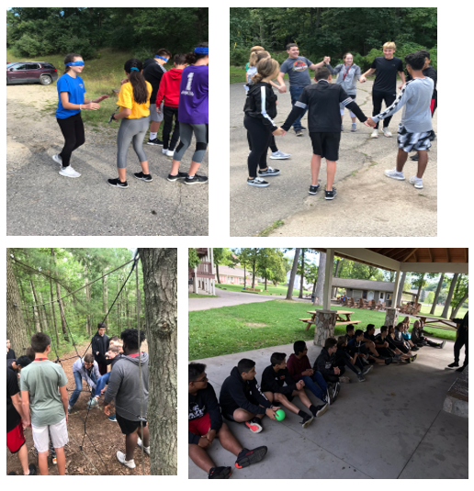
Before school homework/content support with seniors
Focus on time management and organization skills using a common planner
Emphasis on cultivating positive relationships with peers and developing the community atmosphere
Counselor run classes on study skills, goal setting, wellness, time management
Design of Experiments class
Do you want support?

Slide 12
Design of Experiments
Experimental Design
Data Collection
Data Visualization
Scientific Methodology
Data Literacy
Variable Control
Arguing from Evidence
Unit Analysis
Math Stamina
Problem Solving

Slide 13
If you answered YES to many of these questions, then MST may be the place for you!

Slide 14
9th Grade | 10th Grade | 11th Grade | 12th Grade
Advanced Algebra II with Geometry | Math Analysis | AP Statistics | AP Calculus AB or BC
AP Computer Science Principles | MST Advanced Chemistry | AP Chemistry | AP Biology AP Physics C—Mechanics AP Computer Science A AP Environmental Science Microbiology/Genetics
MST Advanced Biology | MST Advanced Physics | AP Environmental Science Microbiology/Genetics AP Biology AP Computer Science A

Slide 15
MST Curriculum
Students will leave this program with:
6—8 credits in science
Minimum of 5 credits in math & computer programming
Participation in up to 8 Advanced Placement (AP) classes
STEM Endorsement on academic transcript

Slide 16
SAT Composite Scores Class of 2023 (1600) | Utica Center for Math, Science and Technology Class of 2025 | Percentile Rank
Median Composite Score | 1330 (1028) | 88th
Top 10% Mean Composite Score | 1518 | 99th
Top 25% Mean Composite Score | 1467 | 97th
Middle 50% Mean Composite Score | 1417 | 95th
Bottom 25% Mean Composite Score | 1197 | 75th
Bottom 10% Mean Composite Score | 1158 | 68th
Range | 1570—1120 | 99th—64th

Slide 17
Valedictorians | Grade Point Average | Composite SAT Score | Difference
MST Valedictorians | 4.16 | 1372 | +183
All other UCS Valedictorians | 4.07 | 1189 | +.09

Slide 18
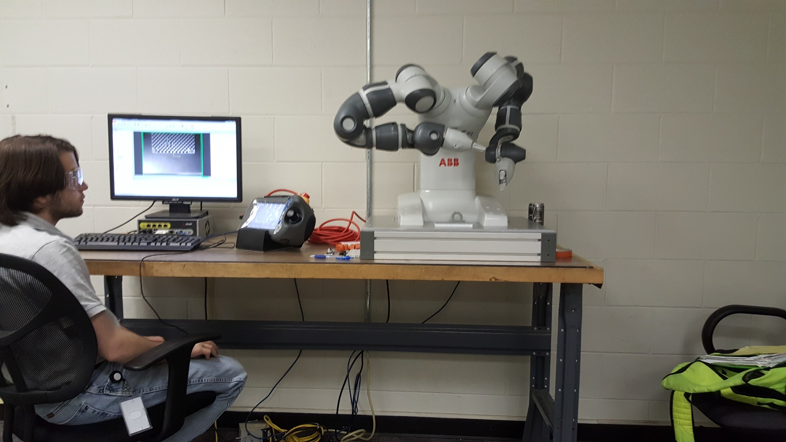
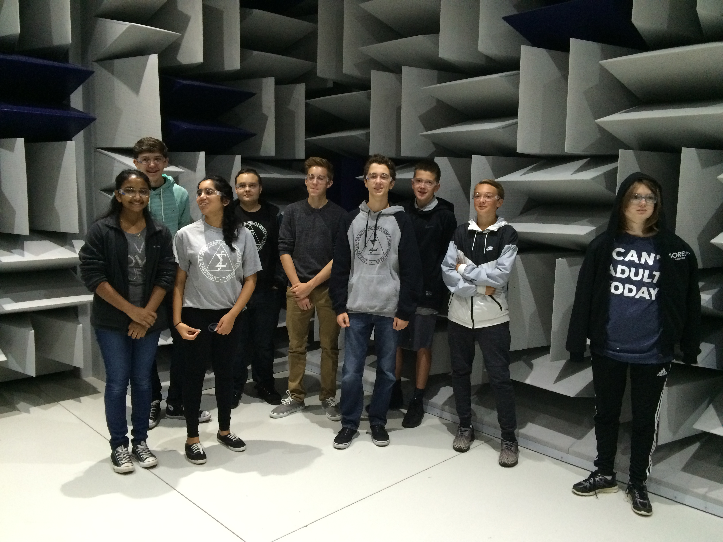
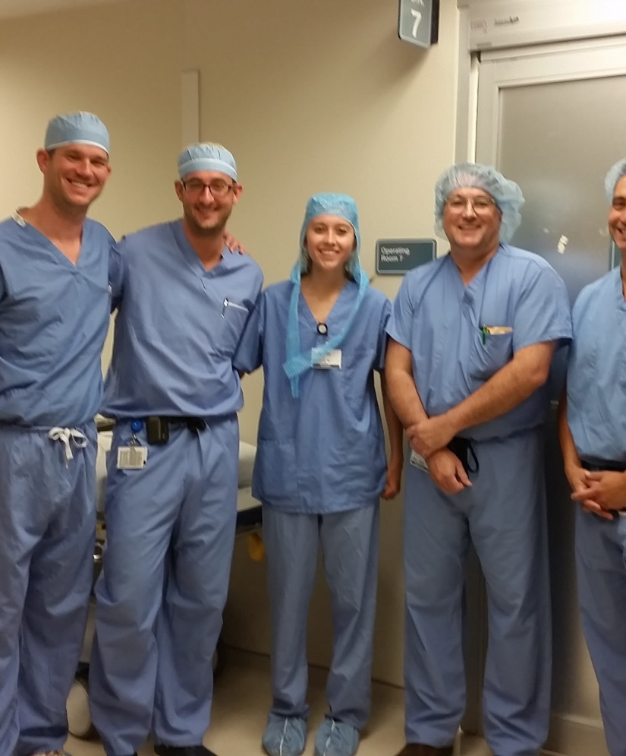
Are you considering a
career as a:
Software Engineer
Surgeon
Biostatistician
Process Development Scientist
Lawyer
Professor
Environmental Engineer
Mechanical Engineer
Chemical Engineer
Clinical Researcher
Dietitian
Graphic Designer
Architect
Financial Advisor
Cybersecurity Analyst
School Administrator
Pharmacist
Dentist
Veterinarian
Electrical Engineer
Teacher
University Admissions Director
Coast Guard Officer
Orthodontist
Software Engineer
Microbiologist
Epidemiologist
Astrophysicist
OBGYN

Slide 19
Application
Available Friday, December 5, 2025, at 4:00 PM
Closes Friday, December 19, 2025, at 4:00 PM
NWEA College and Career ready in Math and Reading
Must have completed Algebra I by the end of your 8th grade year
You may want to consider to scheduling yourself into Algebra 1A via an online course and then complete Algebra 1B over the summer

Slide 20
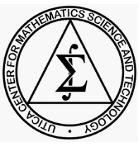


MST Information Night
Thursday, November 20, 2025
6:30 pm
Live Presentation and Open House
ucmst
Utica Center for Math, Science and Technology

